Slide 1
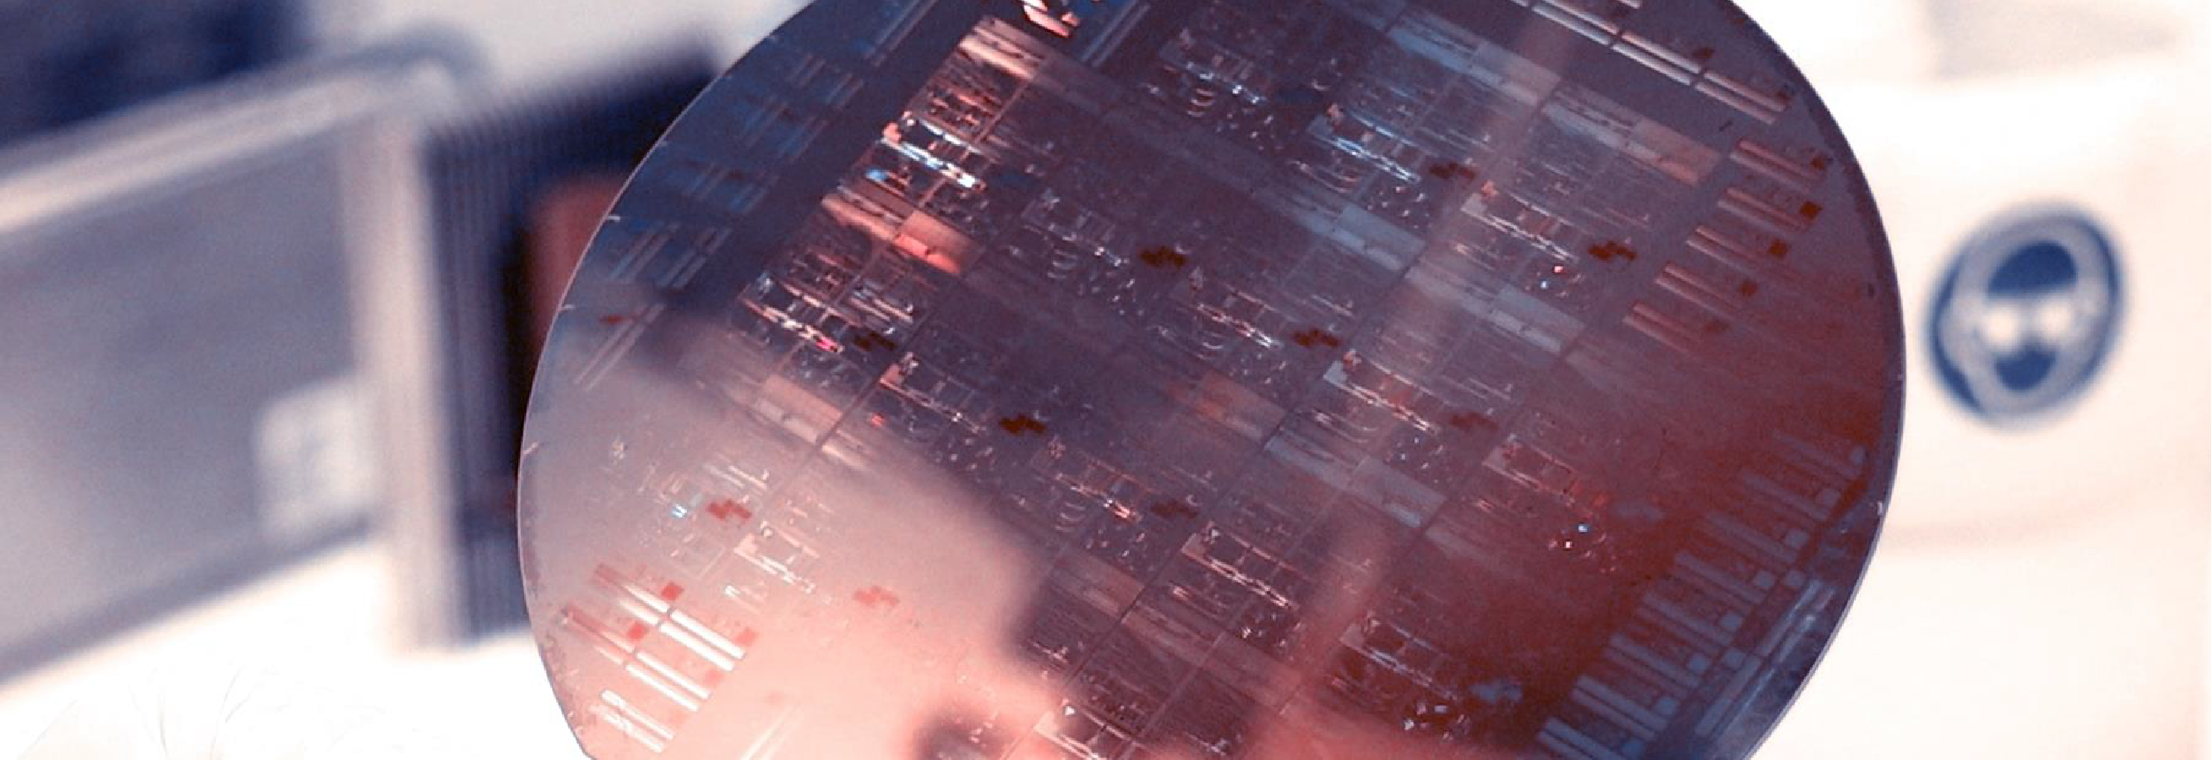
Lab Book 3. Interferometers I - MZI
Student:

Slide 2




Instructions General
SOFTWARE
Python notebook supplied by instructors
SCRIPTS
From Poliformat → download the 030_INTERFEROMETERS_v2025_Student.ipynb
Either run locally or at Cloud workspace
COMPONENT to be studied: Mach-Zendher Interferometer (MZI)
$β_{u}$, $L_{u}$
In2
Out2
$$k_{a}$$
$$k_{b}$$
In1
Out1
$β_{d}$, $L_{d}$

Slide 3

ASSESSMENT #1 – Recap from theory – MZI configurations
Provide one example of implementation for each one of the configurations studied during MZI lecture:
1. Balanced configuration
2. Unbalanced configuration:
2.1. Phase difference
2.2. Delay imbalance
Compute also some examples with $α≠0$ and $γ≠0$
Document all your results (neff, alpha, gamma, transfer function plots, etc.) and comment on the obtained results (in terms of FSR, amplitude, losses, etc.).

Slide 4

ASSESSMENT #2 – Recap from theory – Calculation of $ΔL$
Considering the n_{eff} values for the SOI cross-section, what would be the path difference ($ΔL= L_{u} −L_{d}$) needed to obtain a Free Spectral Range of 40 nm? Introduce the obtained value in the model to check the MZI response.
Hint: We assume 1550 nm as the central design wavelength ($λ_{0}=$1550 nm).
Document all your results (copy here the code employed to obtain the corresponding value)

Slide 5
ASSESSMENT #3 – SAX implementation
Now, we are going to implement the design parameters in the MZI model developed in SAX and compare the response obtained with the one simulated by mathematical formulation. This will help us to identify any error in the definition of the SAX model single components.
In order to implement the SAX model, take as example the following lines:
mzi_test = mzi(wl=wl,
coup_a = ...
wvg_d={"length": l_d, "neff": ...},
wvg_u={"length": l_u, "neff": ...},
coup_b = ... )
H00 = mzi_test["in0", "out0"]
Document all your results (copy here the code employed to obtain the transfer function employing SAX modeling and include the comparative plot of the models)

Slide 6
Extra assessments
Assessment 4. Design an MZI for filtering at a specific wavelength. Calculate and adjust the arm lengths to configure the MZI to have a maximum transmission at 1550 nm.
Assessment 5. Let's see how the response of the MZI varies with the effective index. Vary the effective index of one of the arms and analyze how the spectrum shifts. To do this, you can use the data provided in the .txt files entitled ‘SiN’. Can you give an example of an application where this configuration is used?
Advanced level assessment. Explore how cascading two MZIs affects the transmission spectrum. To do so, design a system in which two MZIs are cascaded. Simulate and observe the spectrum, explaining how the transmission peaks behave.
Document all your results

Slide 7

Thank you

